Slide 1
Programming Fundamentals
Lecture 12

Slide 2
Objectives
Matrices Addition by using arrays
To declare the arrays with user defined size
To find the size of 1D and 2D array

Slide 3
2D Array
What are the meanings of following declaration?
int arr[10][20];
arr is not a matrix with 10 Rows and 20 Columns
The above statement means that the arr is an array of 10 1D arrays, where size of each 1D array is 20

Slide 4
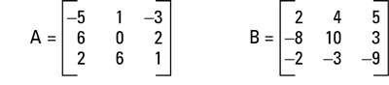
Matrices Addition with Arrays
Write a C++ code to add the following two matrices and display the result of addition in the form of a matrix
Done in Class (Check your lecture notes)

Slide 5
Practice Problem 1
We have written a program to add the two matrices in last example
Modify the code to take the elements of both matrices from user (assume that size of both matrices is 3 x 3)
Do it Yourself

Slide 6
User Defined Size of Array
For 1D array
Ask the user to enter an integer
Use this integer as a size for the declaration of the array
You must take the input from user before declaring the array
int size;
cout<<“Enter the Size of Array : ”;
cin>>size;
int array[size];

Slide 7
User Defined Size of Array
For 2D array
Ask the user to enter two integers
Use these integers as dimensions for the declaration of the array
You must take the input from user before declaring the array
int d1, d2;
cout<<“Enter the 1st Dimension of Array : ”;
cin>>d1;
cout<<“Enter the 2nd Dimension of Array : ”;
cin>>d2;
int array[d1][d2];

Slide 8
Practice Problem 2
We have written a program to add the two matrices in previous problem, now modify that code to take the sizes and elements of both matrices as input from user
Do it Yourself

Slide 9
Finding the Size of 1D Array
What are the sizes of following arrays?
int array1[6] = {1,2,3,4,5,6};
int array2[ ] = {2,3,5,6,8,6,1,5,0,3,6,78};
int array3[ ] = {1,15,0,4,……..,560};
For small arrays we may count the number of elements but for large arrays counting the elements is totally inefficient
Or there are some cases in which we don’t know about the elements or size of an array, but we still want to use it
So we will develope a generalize method to find the size of a 1D array
sizeof() function returns the number of bytes allocated to a variable
Array size = Total bytes allocated to array/bytes allocated to single element
int size = sizeof(array3) / sizeof(array3[0]);

Slide 10



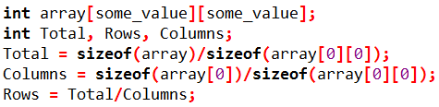
Finding the Size of 2D Array
Let
Rows → Number of 1D Arrays
Columns → Size of each 1D Array
T = Total Elements in the Array
T = Rows x Columns

